Slide 1
OPER 623 – Overviews: Heuristic Methods and Complexity
Lesson 4
What are heuristics?
Computational complexity 50.5

Slide 2
Outline
P versus NP
Proving a problem is hard
Features of good heuristics
Types of heuristics

Slide 3
Outline
P versus NP
Proving a problem is hard
Features of good heuristics
Types of heuristics

Slide 4
Running Time
The exact theoretical running time of an algorithm is a complex expression, we usually just estimate it with asymptotic analysis.
With this we seek to understand the running time of the algorithm on large inputs.
We do this by only considering the highest order term of the expression for the running time of the algorithm, disregarding the coefficient and lower order terms.
For example, f(n) = 6n³ + 2n² + 20n + 45 is asymptotically at most n³

Slide 5
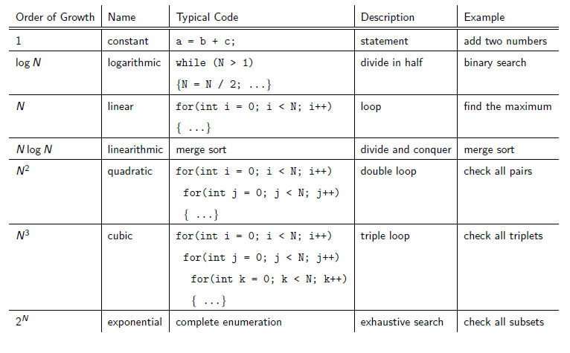
Order of Growth Calculations

Slide 6
Big O Notation
Let f and g be functions
We say that f (n) = O(g(n))
If there exists positive integers c and n₀ such that for every integer n ≥n₀
f (n) ≤ c g(n)
When f (n) = O(g(n)) we say that g(n) is an upper bound for f (n), or more precisely, that g(n) is an asymptotic upper bound for f (n), to emphasize that we are suppressing constant factors.
Example: Let f(n) = 5n³ + 2n² + 22n + 6 Then f(n) = O (n³) Verify: Select c = 6 and n₀ = 10. Is it true that for all n ≥ n₀ 5n³ + 2n² + 22n + 6 ≤ 6n³?

Slide 7
Decision vs Optimization
An optimization question asks: What’s the “best” solution for this problem?
Value Questions
Min (c’x: Ax = b)
What is the shortest tour for a traveling salesman problem?
What is the cheapest facility location?
The decision question is: Does a solution of size x exist?
Yes-No Questions
Is there is a solution of size z or smaller, to (c’x: Ax = b)?
Is there a tour of length z or shorter?
Is there a facility assignment of cost z or less?

Slide 8
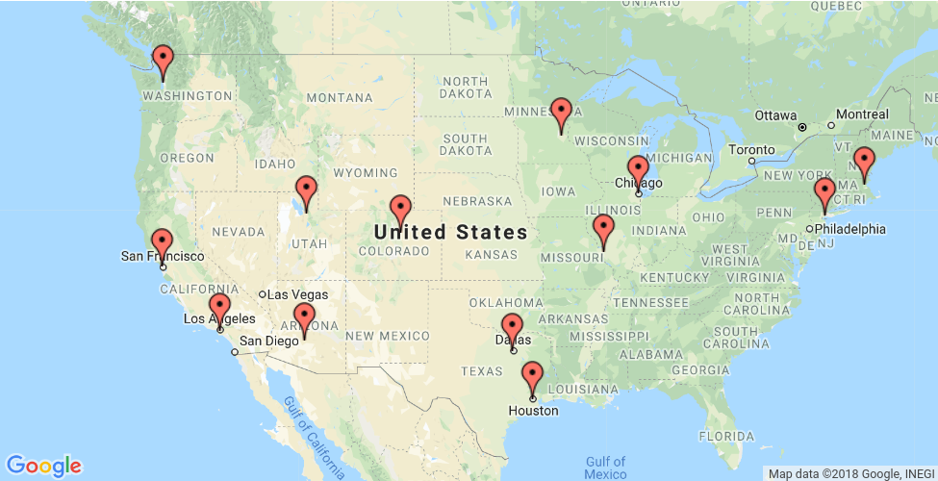
The Traveling Salesman Problem
Example: Visit each state capital exactly once and then return to starting city - traveling shortest distance

Slide 9
The Traveling Salesman Problem
Lesson 4 - TSP.ipynb

Slide 10
P vs NP
We mentioned that one of the main motivators for heuristics are “hard” problems. What does this mean?
Why can we solve some problems to optimality (like linear programs) and not others (like the TSP)?
First the “easy” problems: The Class P
There exists types of problems for which a polynomial time algorithm answering the decision question has been proven to exist.
By polynomial algorithm we mean that for any instance of this problem of size n we can bound the run time by a sufficiently large polynomial number k such that the algorithm in its worst case runs in at O(n^{k}) time
We call these problems “easy” or “tractable”
Linear Programming exists in P

Slide 11
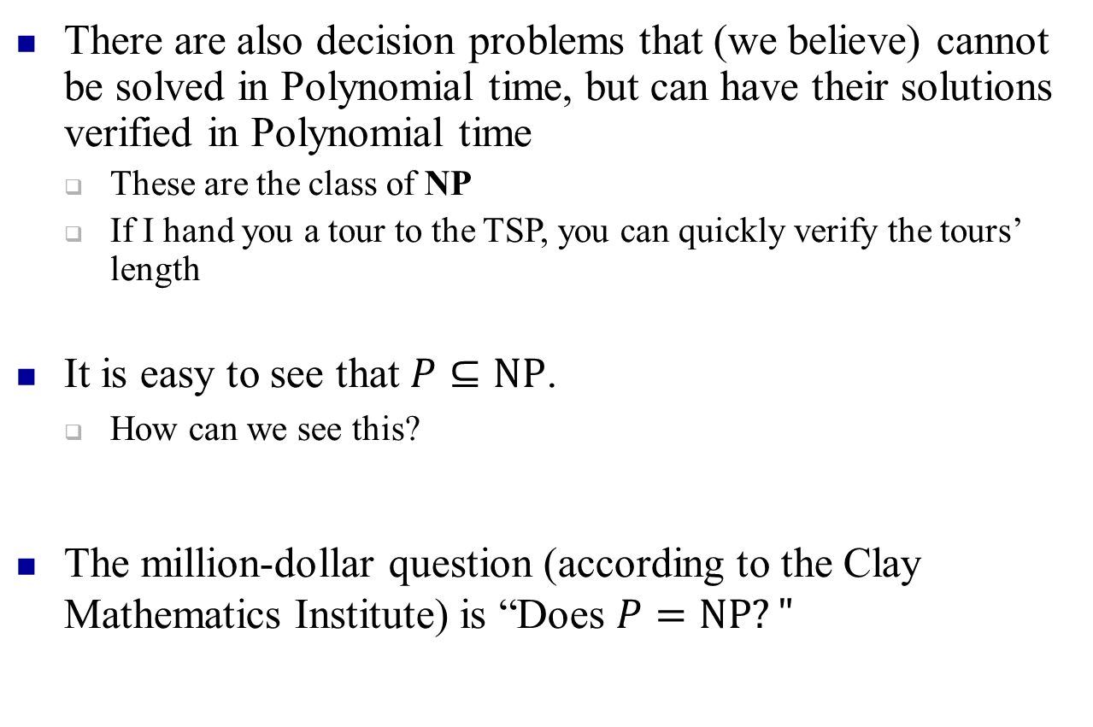
P vs NP
There are also decision problems that (we believe) cannot be solved in Polynomial time, but can have their solutions verified in Polynomial time
These are the class of NP
If I hand you a tour to the TSP, you can quickly verify the tours’ length
It is easy to see that $P⊆NP$.
How can we see this?
The million-dollar question (according to the Clay Mathematics Institute) is “Does $P=NP?"$

Slide 12
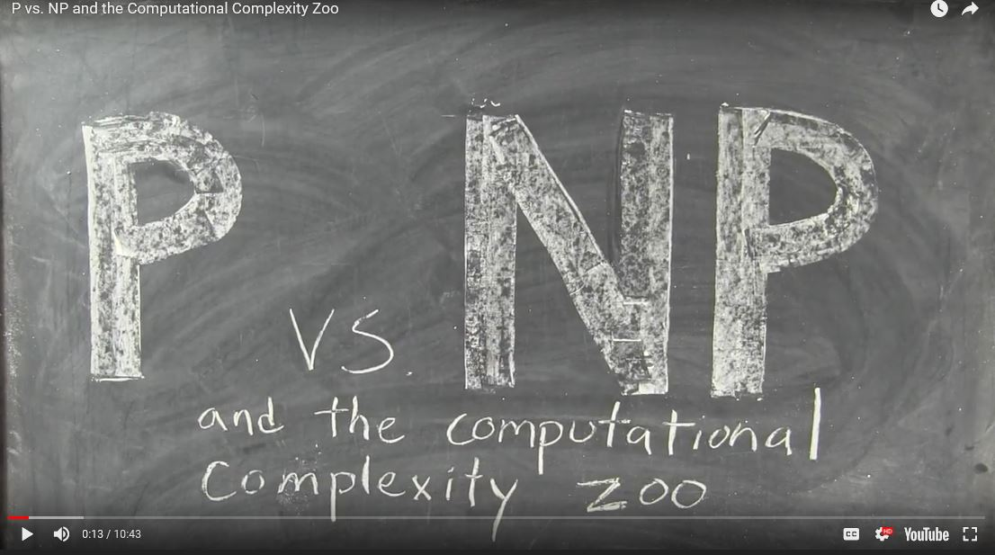
P vs NP Video

Slide 13
Outline
P versus NP
Proving that a problem is hard
Features of good heuristics
Types of heuristics

Slide 14
Proving problems are hard
Let us imagine we have two problems, imaginatively called P₁ and P₂
Suppose problem P₂ can be solved by algorithm B
Suppose we can transform any instance of problem P₁ into an instance of P₂ via a polynomial function A
Then clearly we can use this transformation plus algorithm B to solve P₁
Thus problem P₂ is at least as hard as (and possible harder) then problem P₁

Slide 15
NP-Hard and NP-Complete
If P₂ is such that every problem in NP can be transformed into P₂ then P₂ is called NP Hard
If P₂ is also in NP, then it is called NP Complete
So NP Complete problems are the set of the “hardest” problems in NP.

Slide 16
Valid Transformations
Input: Instance of a known decision version of problem P₁
Output: Instance of problem of interest P₂ Transformation must satisfy three criteria
Yes-2-Yes: All Yes instances of P₁ must be Yes instances for P₂
Yes-from-Yes: All Yes instances of P₂ must be from Yes instances of P₁.
Transformation must be Fast (polynomial)
Tovey 2002

Slide 17
NP Hardness Proofs
Let us consider NP Hardness proofs as a flowchart.
We want to prove that P₂ is NP-Hard
Given: Any instance I of known NP-Hard problem P₁ we need a
Polynomial transformation f such that f(I) are instances of P₂
With properties that:
Any Yes for P₁ must generate a Yes for P₂
Any Yes for P₂ must be from a Yes from P₁
Transformation f must be fast
Yes Instance I of P₁
f
Yes Solution to I
Yes Solution to P₂
f ⁻¹
Instance f(I ) of P₂
Algorithm for P₂
No Instance I of P₁
No Solution to P₂
f ⁻¹
No Solution to I
f
An algorithm for P₁
Dasgupta, Papadimitriou, and Vazirani

Slide 18
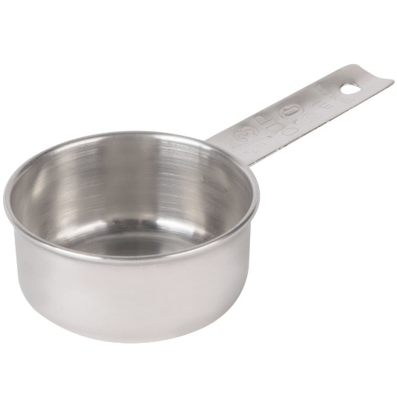


NP Hardness Proofs
How to keep it straight?
Am I proving P₁ is NP-Hard or P₂ is NP-Hard?
Consider below machinery as pouring water between measuring cups.
If I can pour all the water from the measuring cup I know is NP-Hard into the unknown cup then the unknown cup is at least as big (aka hard)
Known NP-Hard Problem P₁
Problem of interest P₂
Yes Instance I of P₁
f
Yes Solution to P₂
Yes Solution to I
f ⁻¹
Instance f(I ) of P₂
Algorithm for P₂
No Instance I of P₁
No Solution to P₂
f ⁻¹
No Solution to I
f
An algorithm for P₁

Slide 19
Example 3SAT INDEPENDENT SET
Prove that the INDEPENDENT SET problem is NP-Hard given that the 3SAT problem is NP-Hard
3SAT:
Given a set of clauses each with three or less literals find a satisfying truth assignment (¬x∨y∨¬z)∧(x∨¬y∨z)∧(x∨y∨z)∧(¬x∨¬y)
INDEPENDENT SET
Given a graph and a number g find a set of g pairwise non-adjacent vertices.
Clause
Literal
“OR”
“NOT”
“AND”

Slide 20
Example 3SAT INDEPENDENT SET
Prove that the INDEPENDENT SET problem is NP-Hard given that the 3SAT problem is NP-Hard
3SAT:
Given a set of clauses each with three or less literals find a satisfying truth assignment (Decision Version: Does any solution to the instance exist?) (¬x∨y∨¬z)∧(x∨¬y∨z)∧(x∨y∨z)∧(¬x∨¬y)
INDEPENDENT SET
Given a graph and a number g find a set of g pairwise non-adjacent vertices. (Decision Version: Does a set of size g pairwise non-adjacent vertices exist?)
Clause
Literal
“OR”
“NOT”
“AND”

Slide 21
NP Hard Proofs:
Develop a transformation that takes an instance of a known NP-Hard problem and transforms it into an instance of the problem in question such that it meets the three criteria in Tovey 2002.
¬
y
y
y
¬
x
z
x
z
x
z
¬
3SAT to IS TRANSFORMATION
Given any instance of the known NP-Hard problem 3SAT perform the following transformation:
Set g = # clauses
Construct a graph where each literal becomes a node
Each clause forms a triangle or pair with arcs between
Connect opposite truth value literals via arcs
Dasgupta, Papadimitriou, and Vazirani

Slide 22
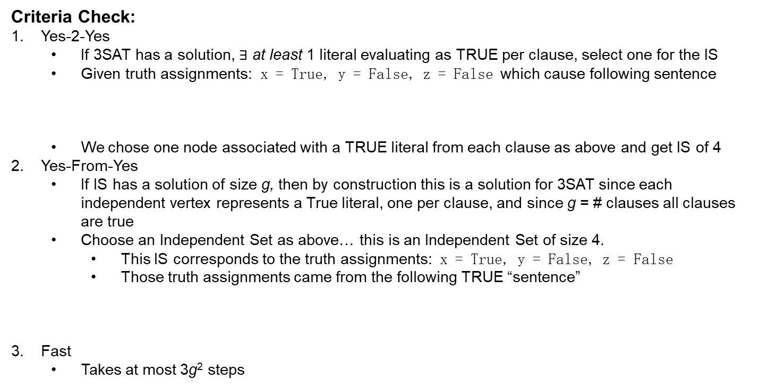
Criteria Check:
Yes-2-Yes
If 3SAT has a solution, $∃$ at least 1 literal evaluating as TRUE per clause, select one for the IS
Given truth assignments: x = True, y = False, z = False which cause following sentence
We chose one node associated with a TRUE literal from each clause as above and get IS of 4
Yes-From-Yes
If IS has a solution of size g, then by construction this is a solution for 3SAT since each independent vertex represents a True literal, one per clause, and since g = # clauses all clauses are true
Choose an Independent Set as above… this is an Independent Set of size 4.
This IS corresponds to the truth assignments: x = True, y = False, z = False
Those truth assignments came from the following TRUE “sentence”
Fast
Takes at most 3g² steps
(¬x∨y∨¬z)∧(x∨¬y∨z)∧(x∨y∨z)∧(¬x∨¬y)
( F∨F∨ T)∧(T∨ T∨F)∧(T∨F∨F)∧( F∨ T)
(¬x∨y∨¬z)∧(x∨¬y∨z)∧(x∨y∨z)∧(¬x∨¬y)
( F∨F∨ T)∧(T∨ T∨F)∧(T∨F∨F)∧( F∨ T)

Slide 23
NP-Hard and NP-Complete
Why do we care Dr. Cox?
By definition no (known) efficient algorithms exist for NP-Hard problems. This makes that class of problems perfect candidates for heuristics
Developing an intuition that a problem is NP-Hard is therefore vital
Knowing how to avoid modeling a problem in a fashion that makes it “hard” is also useful
Use the right algorithm for the right problem.

Slide 25
Things that make problems Hard
Dividing up work/resources/money perfectly evenly
Make sequencing decisions based on past knowledge
Splitting objects into subsets where each subset must satisfy a constraint
Finding the largest substructure that satisfies a property
Tovey 2002

Slide 26
Outline
P versus NP
Proving a problem is hard
Features of good heuristics
Types of heuristics

Slide 27
Features of Good Heuristics
Simplicity - simple to understand and implement
Reasonable storage requirements
Speed - linear growth in problem size
Accuracy of solution
Good answers most of the time
Low variance about these good answers
Not a wide range of performance per problem instance
Robustness
Handles wide variety of problem instances reasonably well with little to no performance differences due to minor input changes

Slide 28
Features of Good Heuristics
Multiple starting points
Output should be robust to different starting points
Good stopping criteria
avoids search stagnation
completes the solution process
provides the tradeoff between improvement potential and computational effort

Slide 29
Features of Good Heuristics
Interactive (with the analyst)
can interact with heuristic
can tune the heuristic; change parameters of search
provides intuitive feel for the problem
finds initial solutions
helps make decisions at intermediate steps of search
No Free Lunch Theorem
No “magic bullet”, one-size-fits-all algorithm can exist
If an algorithm provides above average performance for one type of problem it must provide sub-par performance for others

Slide 30
Outline
P versus NP
Proving a problem is hard
Features of good heuristics
Types of heuristics

Slide 31
Types of Heuristics
Constructive
Neighborhood Search
Meta

Slide 32
Types of Heuristics Constructive
Constructive methods
Build a feasible solution
Generally these are single solutions, deterministic in nature, and greedy type of heuristics
Approaches
Primal approach - start with some feasible (empty?) solution and build the solution from there; primal feasibility is not violated
Dual approach - start with some infeasible solution and build or destruct the solution until feasibility obtained

Slide 33
Types of Heuristics Constructive
Example – 0-1 Knapsack Problem
Calculate weighted value of each item and then add the best first until you run out of room.

Slide 34
Types of Heuristics Neighborhood Search
Local improvement (Local Search) methods
At some feasible (or infeasible) solution…
Uses a predetermined rule set to determine the set of elements (solutions) you can choose from
Neighborhood Definition
Uses a predetermined rule set to pick from that set of elements
Neighborhood Evaluation

Slide 35
Types of Heuristics Neighborhood Definition
What are the possible elements to select?
Move definition
What is a legal move?
Bit toggle, k-steps
Neighborhood
All solutions reachable from the current solution via a move
Too large neighborhood – takes too long to evaluate
Too small neighborhood – takes too long to change the solution quality
What is the right size?

Slide 36
Types of Heuristics Neighborhood Evaluation
Choosing a solution from your neighborhood
First “improving” neighbor chosen?
“Best” neighbor chosen (Hill-climbing)?
Any random neighbor chosen?
Random neighbor only if better?
A worse neighbor sometimes?
Others??

Slide 37
Types of Heuristics Neighborhood Search
Landscape
Defined by the objective function, the set of solutions, and the neighborhood definition
You have the most control over the neighborhood definition
Some landscapes are better than others
What qualities make a good landscape?

Slide 38
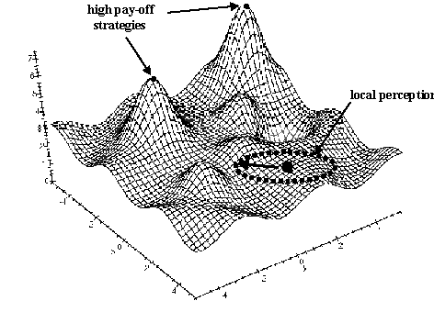
Landscapes
Great place to be for a maximization problem as all neighbors are much less
Horrible place to be for a maximization problem as all neighbors are much less
Horrible place to be for a minimization problem as all neighbors are pretty identical

Slide 39
Types of Heuristics Meta
Meta-heuristics
A master strategy that guides and modifies other heuristics to produce solutions beyond those that are normally generated in a quest for local optimality - Laguna
Examples:
GRASP, Simulated Annealing, Tabu Search, Scatter Search, Ant Colony, Genetic Algorithms
Differ in how they
Escape local optima
Intensify the search
Diversify the search

Slide 40
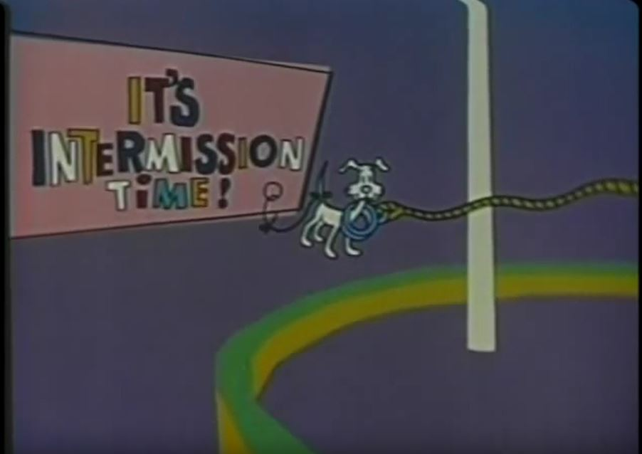
Break

Slide 41
INDEPENDENT SET CLIQUE
Prove that the CLIQUE problem is NP-Hard given that the INDEPENDENT SET problem is NP-Hard
What is the CLIQUE problem?
A subset of vertices are called a clique if they induce a complete graph (i.e they are pairwise connected)
Decision Question: Does below graph contain a Clique of size 4? Yes!
Clique of 4
Not a Clique (not fully connected)
Clique of 3

Slide 42
INDEPENDENT SET CLIQUE
How would we prove that CLIQUE is NP-Hard?
Create a transformation that takes any instance of INDEPENDENT SET and creates an instance of CLIQUE so that the three criteria in Tovey are met.
Try following INDEPENDENT SET instance for ease of use:
Does an independent set of size 1 exist? Of size 2?
Of size 3?
Of size 4?
Of size 5?
Of size 6?

